Slide 1
EXCELERATE PRESENTATION
TEAM 2A
Optimising Data for growth-driven solutions

Slide 2
THE ANALYTICS TEAM
Project Leads: Nirnay Basrur, Sriya Reddy, Aravindh M
Project Scribe: Keziah Asante
Project Members: Lerato Moloto, Haadi Sanusi, Govardhan K, Winifred Agu

Slide 3
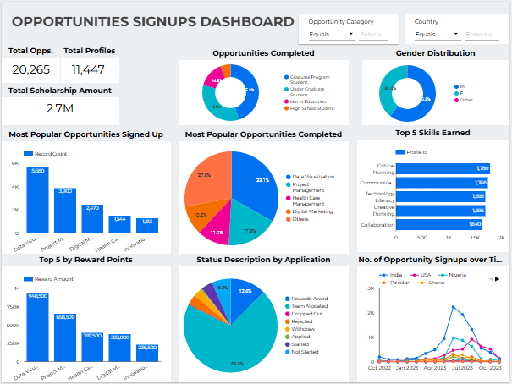
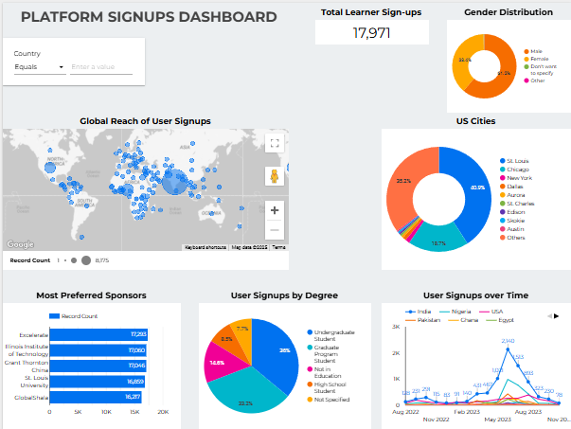
DASHBOARD OVERVIEW

Slide 4
CHOICE OF VISUALS & KEY DESIGNS
Use of Pie Charts for Distribution Metrics
Use of Bar Charts for Rankings & Comparisons
Line Chart for Trends Over Time
Bubble Map for Global Outreach
Filters for Data Filtering
Consistent Color Palette
Bold Fonts for Key Figures
Minimal Clutter
Logical Flow

Slide 5
KEY QUESTIONS & ANSWERS
How many people are signed up on the platform, and how many of those have signed up for opportunities?
What are the top 10 countries learners have signed up from?
What are the cities in the US learners have signed up from?
Which is the most popular opportunity learners have signed up for?
Which is the most popular opportunity learners have completed?
What is the demographic (gender, student status, etc.) of those who have signed up and completed?
What are the most gained skills on Excelerate?
How much is the total scholarship awarded and through which opportunities?

Slide 6
Total Learners & Opportunity Signups
Total Learners by Opportunity Sign-ups
11447
Total Learner Signups
17971
User Engagement Rate
63.7%

Slide 7
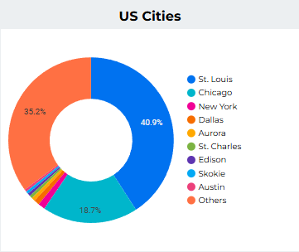
Learner Signups by Top 10 Countries & US Cities
TOP 10 COUNTRIES
India: 8175 learners
Nigeria: 3047 learners
USA: 2545 learners
Pakistan: 1109 learners
Ghana: 732 learners
Egypt: 567 learners
Bangladesh: 180 learners
Vietnam: 178 learners
Kenya: 167 learners
Nepal: 113 learners
TOP US CITIES

Slide 8
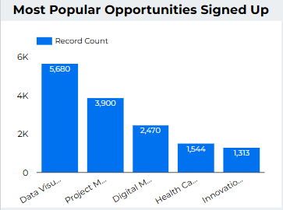
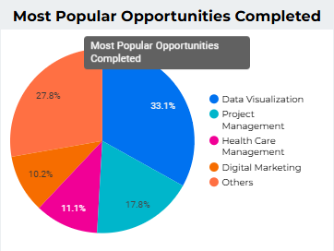
Most Popular Opportunity Signed Up For & Completed

Slide 9
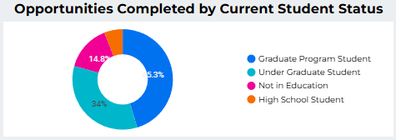
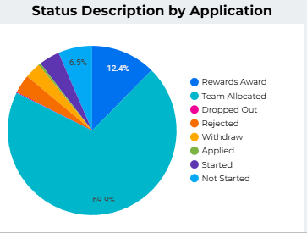
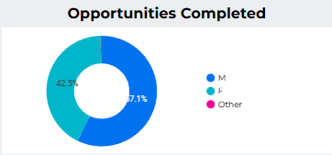
Demographics of Signups & Completions

Slide 10
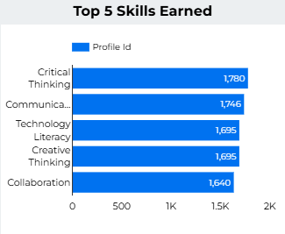
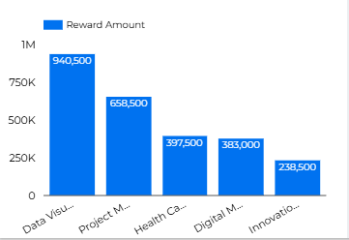

SKILLS GAINED & SCHOLARSHIPS AWARDED
Key Opportunities by Scholarship Amount

Slide 11
Challenges Encountered & Solutions
Time Zone Conflicts: Collaborated when all the time zones fell correctly for all of us as a group
Incomplete Data Pre Processing: Ensured the team members got together and correctly formatted the data in a consistent flow.
Communication: Task not properly discussed and communicated, hence held a con–call every week before each pending task and progress monitoring.

Slide 12
ORGANISATIONAL VALUE & STAKEHOLDER DECISION-MAKING
User Growth & Engagement.
Geographic Expansion Strategy
Opportunity Optimization
Demographic Insights for Personalization
Impact Measurement
Growth Strategy Planning

Slide 13
UI INTERACTION & VISUAL INSIGHTS
Dashboard Link: https://lookerstudio.google.com/reporting/d97e4fbb-dec9-4c30-9117-5babdb058c44

Slide 14
THANK YOU!!!

